Slide 1

Python Level 2
Lesson 8: What kind of day has it been?

Slide 2
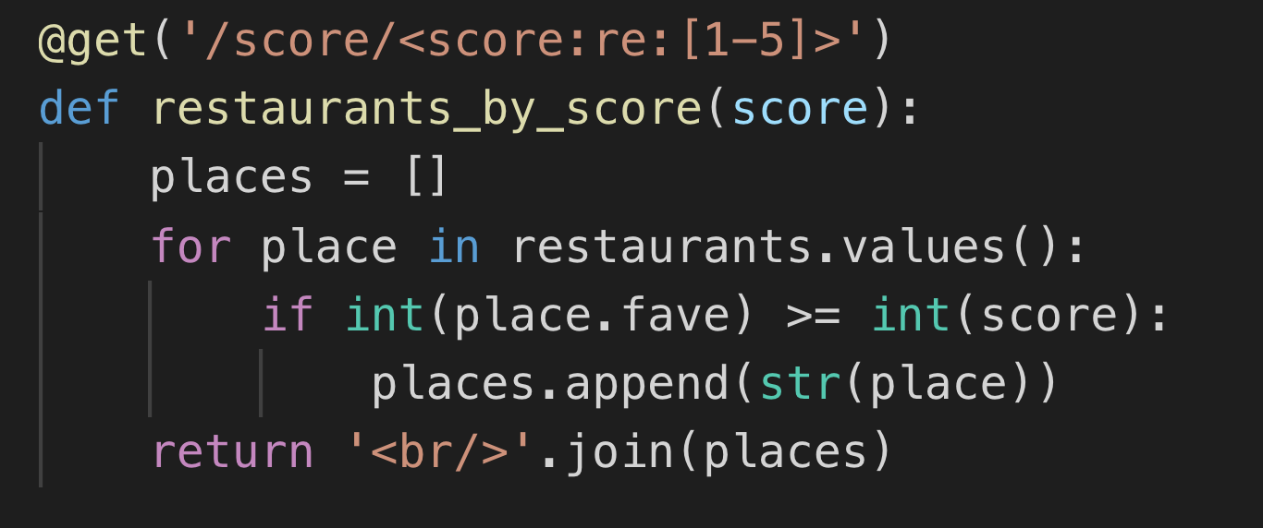

Where did we get to?

Slide 3
The Roads less travelled
What we haven’t covered:
XML
SQL and NoSQL Databases
Raw TCP sockets
Other things… ?
What might our code look like if we were to use these storage methods / technologies?

Slide 4
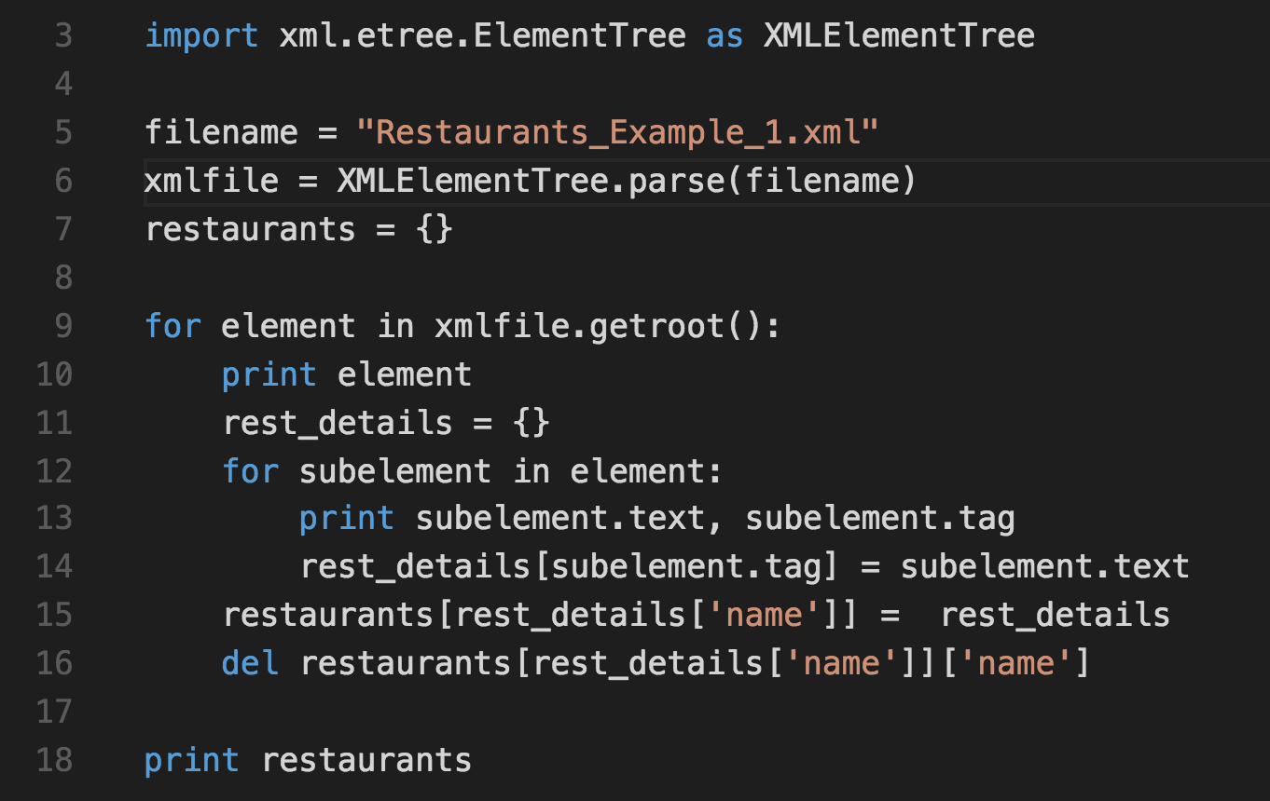
XML
Notes:
This is xml_reader.py from the examples directory. Take a look at what happens if we try to read the other xml files. We might need the subelement.attrib property

Slide 5
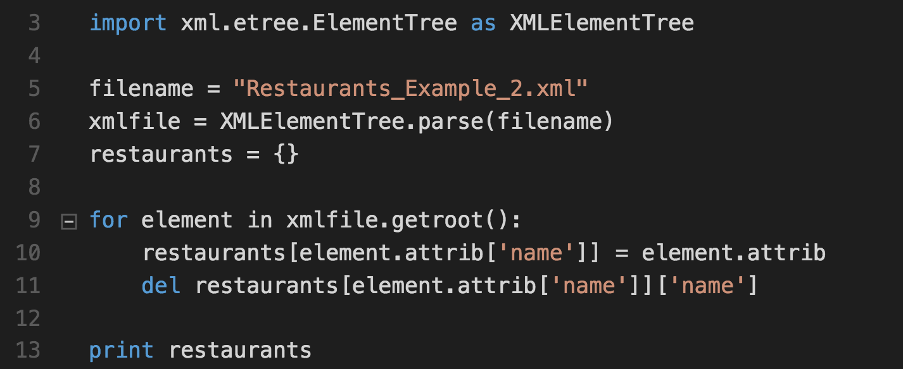
XML - Continued
Different XML Schemas require very different code to understand them
Notes:
Have a go at writing a parser for example 3

Slide 6
SQL
Which implementation?
MS – SQL
MySQL / Maria DB / Aurora
SQLite
Oracle, etc…

Slide 7
SQL
Which implementation?
MS – SQL
MySQL / Maria DB / Aurora
SQLite
Oracle, etc…
Python doesn’t have a single DB interface, unlike Perl (DBI), Java (JDBC), etc
DB-API is a standard for DB connectivity modules.
Notes:
The great thing about standards is of course that there are so many of them.

Slide 8
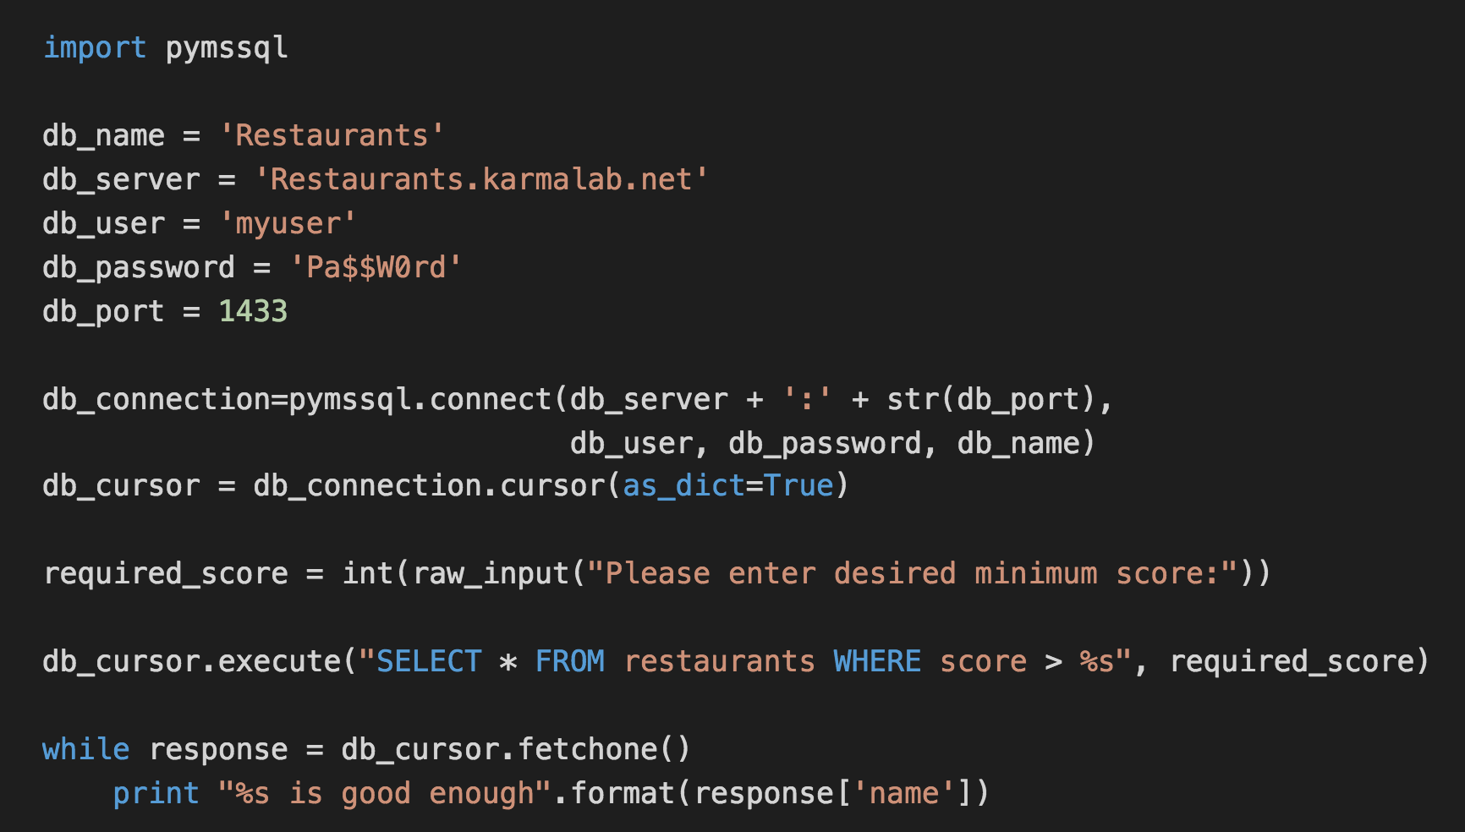
FreeTDS (MS SQL Server) Example

Slide 9
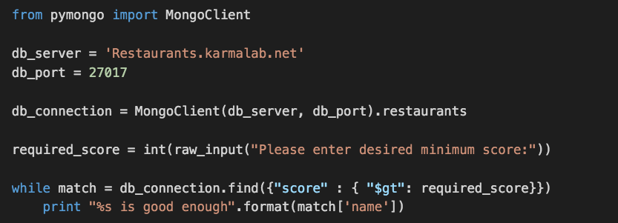
NoSQL (MongoDB)

Slide 10
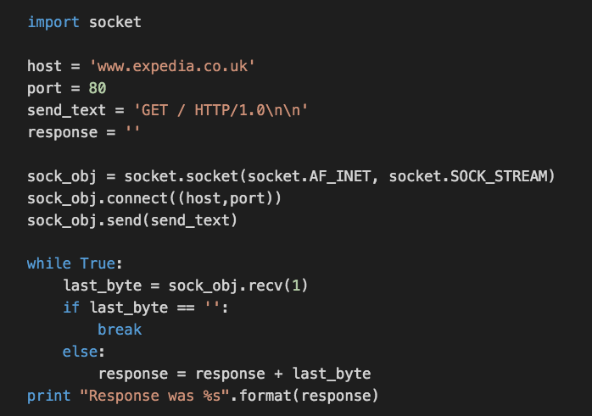
TCP Sockets

Slide 11


Where we’re going, we don’t need roads!
Python type annotation:
The feature that broke Guido: Assignment Expressions (coming in Python 3.8)

Slide 12
UI is King
Introducing Trip Deviser! The next big thing in social review sites
Download the files from http://go/rwnnif8m
Open tripdeviser.html in your browser

Slide 13
Today’s Exercise
Modify restaurant_webserver.py so that we can visit:
http://127.0.0.1:8080/tripdeviser/pret (for example)
It should display the HTML from tripdeviser.html with the details of pret filled in.
Complete the POST method for /addRestaurant
When data is sent back, we can process it to do something
There’s a super-secret hidden third part of this exercise. Can you find it and complete it too?

Slide 14
Hints
open('filename') will be useful in reading from a file
str(restaurants['pret']) gives the details of pret in a useful form
my_string = my_string.replace('AAA', 'BBB') will replace all instances of ‘AAA’ in my_string with ‘BBB’

